Slide 1
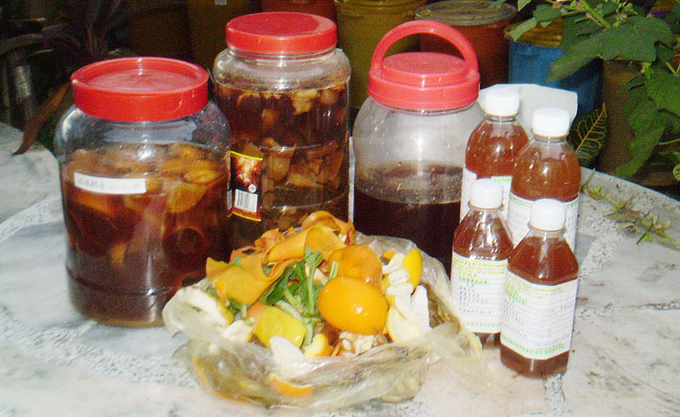
ENVIRONMENTAL FRIENDLY ENZYME
By: Dr.（H） JOEAN OON 温秀枝医师
Email: joeanoon@yahoo.com Tel:604-8901279

Slide 2

Change garbage to enzyme let
Garbage enzyme saves the earth
& protects our next generation

Slide 3
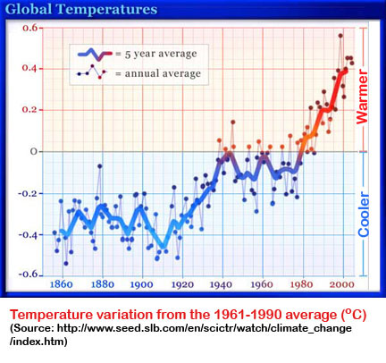
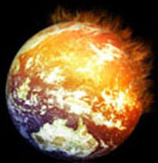
INTRODUCTION
Our Earth is getting warmer and warmer each day. This effect is known as ‘Global Warming’.

Slide 4
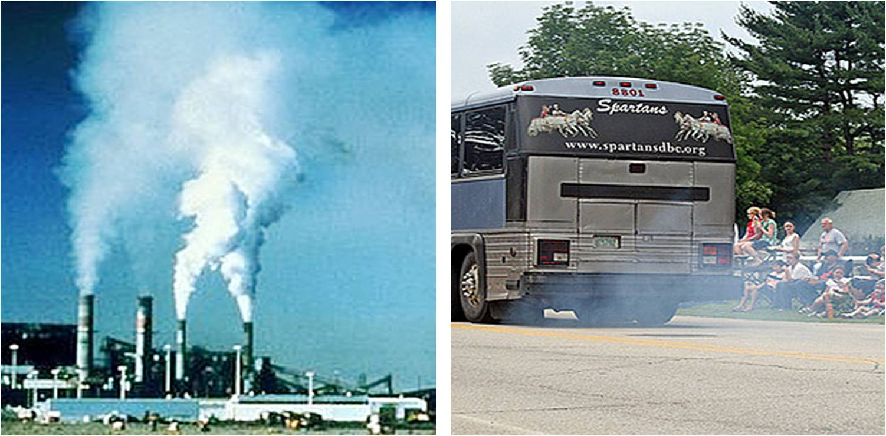
THE MAIN CAUSE: The Greenhouse Gases
Human activities have built a thick blanket of harmful gases around our Earth. These gases are known as
‘The Greenhouse Gases’.
coal power plant (carbon dioxide) exhaust smoke (carbon monoxide)

Slide 5
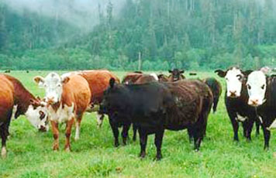
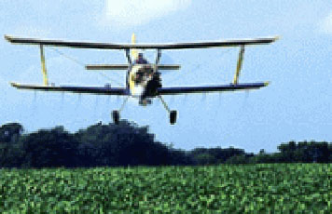
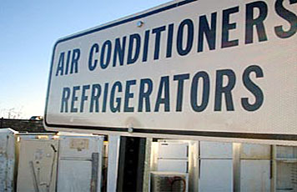
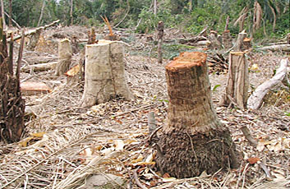
raising farm animals (methane) chemical fertilizer (nitrous oxide)
refrigerants (CFC chlorofluorocarbons) deforestation (reduced of oxygen)

Slide 6
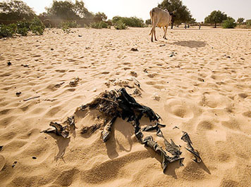
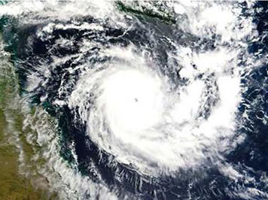
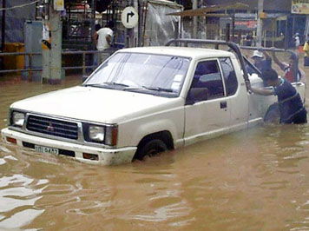
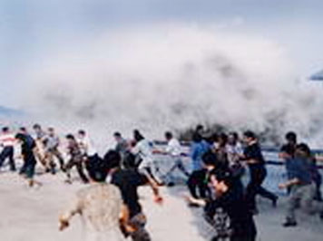
THE EFFECTS: Drastic Climate Changes
drought
cyclone
flash flood
tsunami

Slide 7
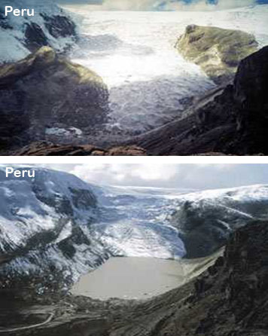
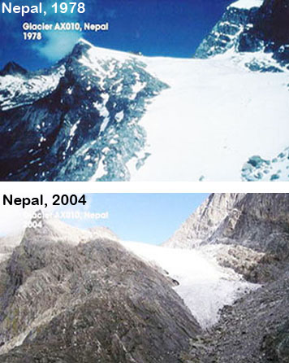
Rising Sea Level 1: Retreating of Glaciers
past
present

Slide 8
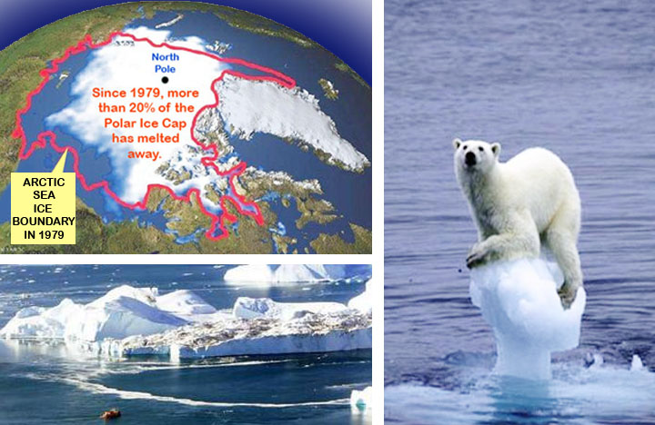
Rising Sea Level 2: Melting Ice Caps
past
present

Slide 9
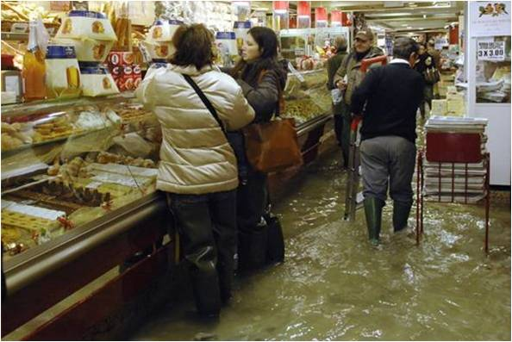

Slide 10
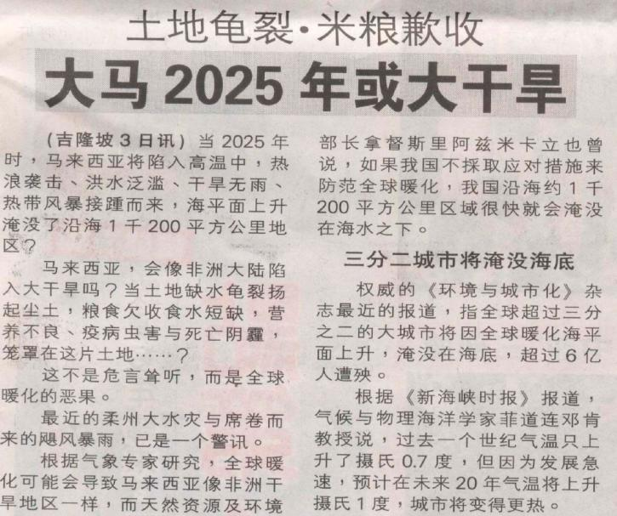
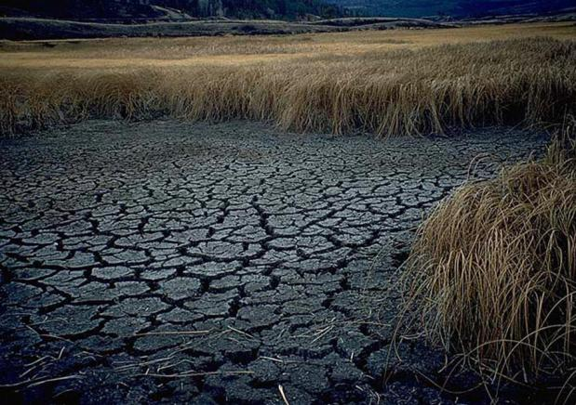
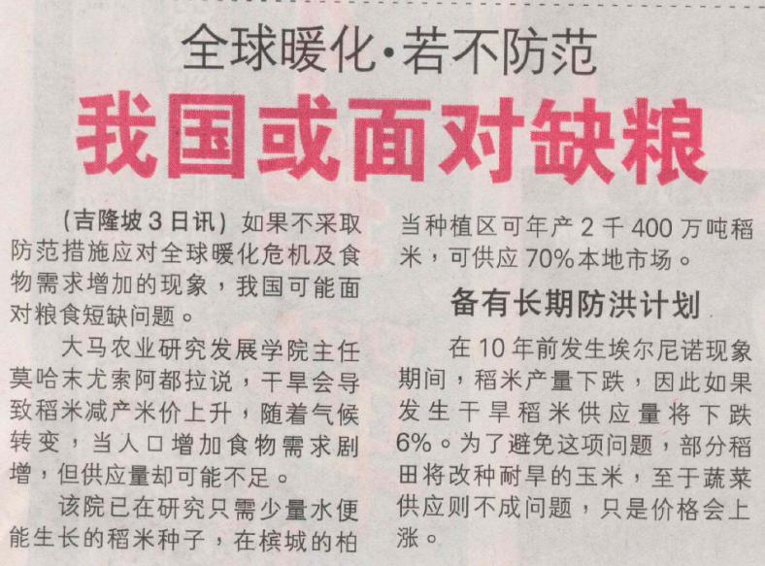
NST 2007/05/03
GLOBAL WARMING: Final warning...
Will Malaysia be arid like Africa?

Slide 11
Our Objective目标
Reduce Global Warming thus assuring future existence of our next generation
减少全球暖化,
保护我们的下一代

Slide 12
Reducing environment pollution through recycling kitchen waste
从再循环厨房的废物或
垃圾来减少环境的污染

Slide 13
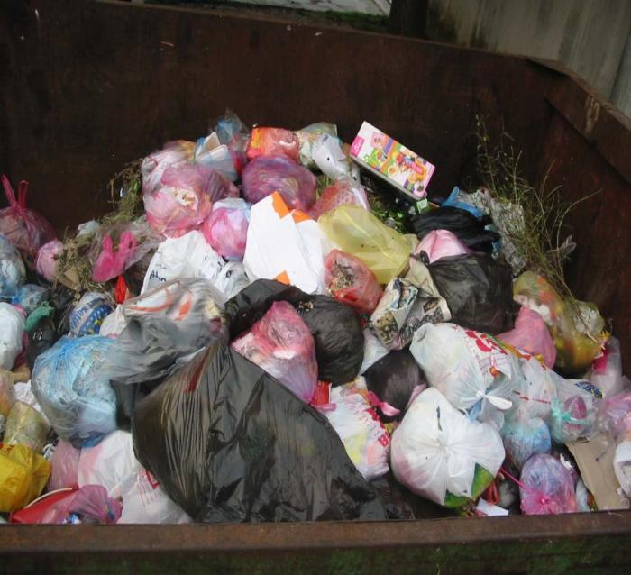
Methane Gas not only given out by animals waste gas, burning fossil fuels and also by rotting plants and rubbish. It trap about 21 times more heat than CO₂.
Not only smelly also create Methane Gas

Slide 14
The % of waste produced from household
Wet rubbish
45%
Dry rubbish
55%

Slide 15
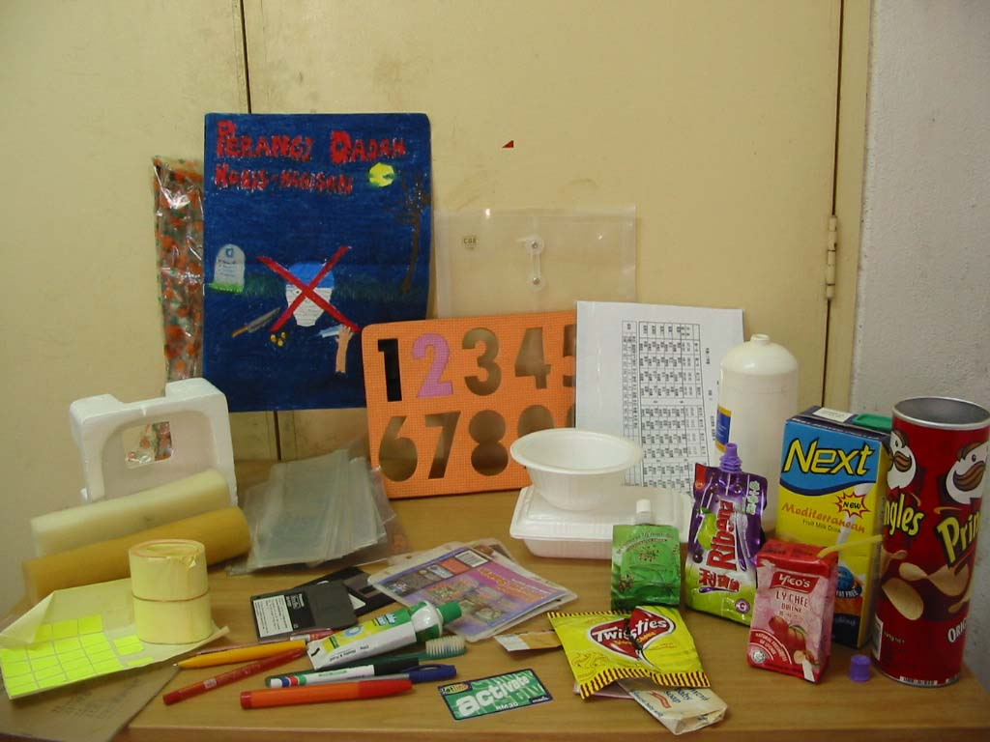
Avoiding usage of non-recycle goods or product,
Such as：
> Bring our own utensil when purchasing food.
> Don’t use plastic bag or poly form.
尽量使用可循环物品
如：
打包食物用自家盒子
买铁罐装食品
Non-recyclable items
不可再循环物品

Slide 16
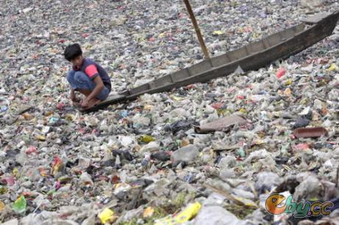

Slide 17
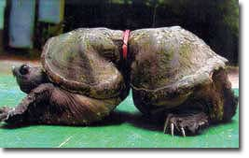
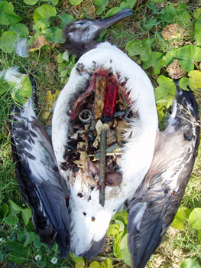
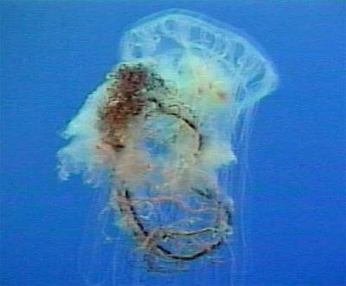

Slide 18
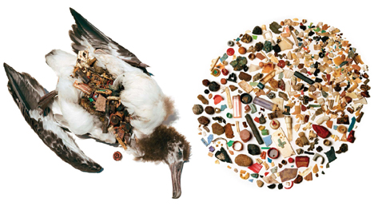
Sea Bird

Slide 19
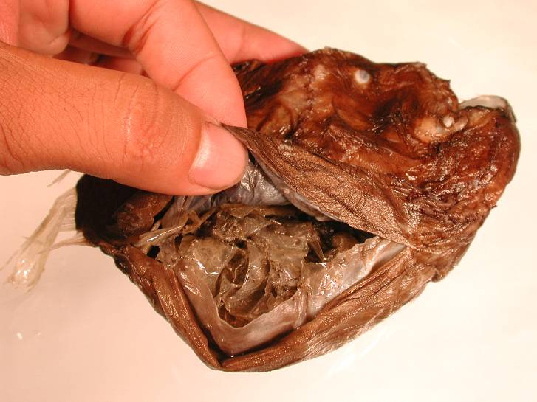
Deep Sea fish 2000-2500m
Plastic Bag !

Slide 20
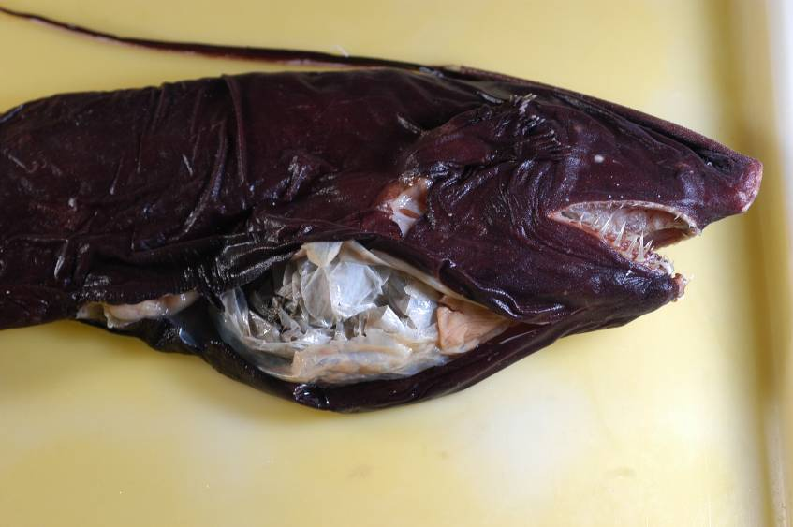
Deep Sea fish 3000-4000m
Plastic Bag !!

Slide 21
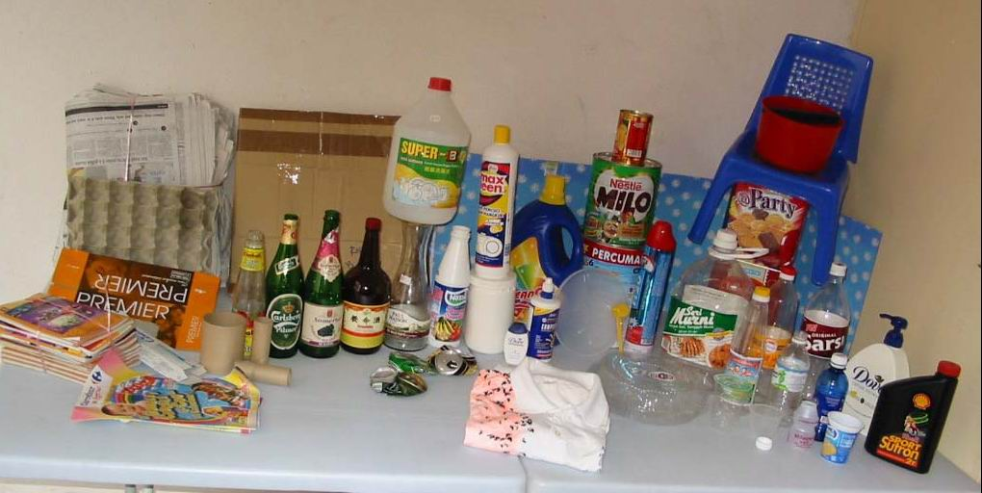
Household recyclable items: paper, plastic item, glass, aluminum, steel, electronic item, cloths, toys, shoes, furniture, hand bag, car battery, oils, candle and etc
可再循环物品 :
纸, 塑膠品, 玻璃, 铝, 铁, 电子废料, 衣服, 玩具, 鞋子, 手提包, 旧傢私, 汽车电池,废油, 蜡烛 等.
Can be recycle
再循环
垃圾一定要分類~給地球喘息的空間

Slide 22
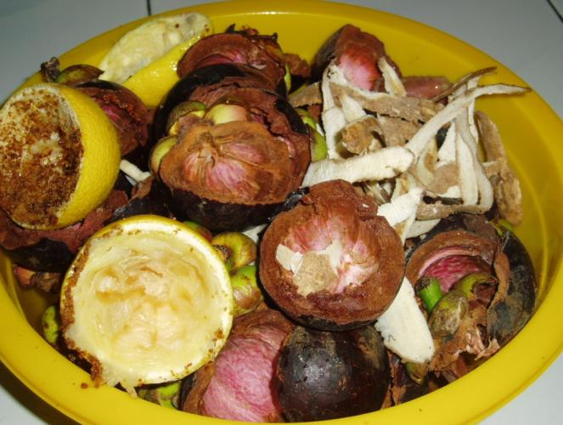
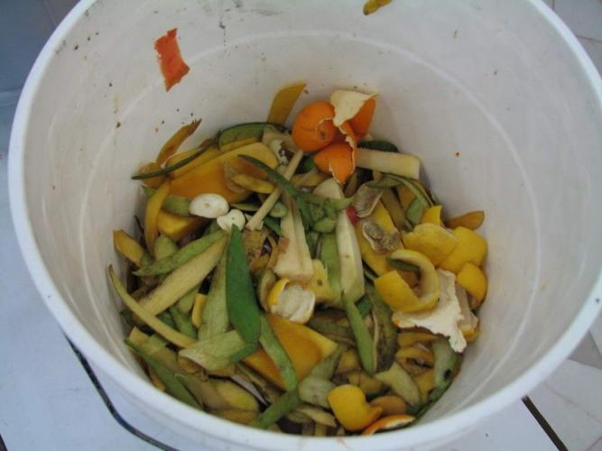
Wet kitchen waste
Fruit Skin, Vegetable and etc
有机垃圾 - 厨房废料
果皮, 蔬菜废料等
回收当环保酵素原料
Materials for Making Garbage Enzyme

Slide 23
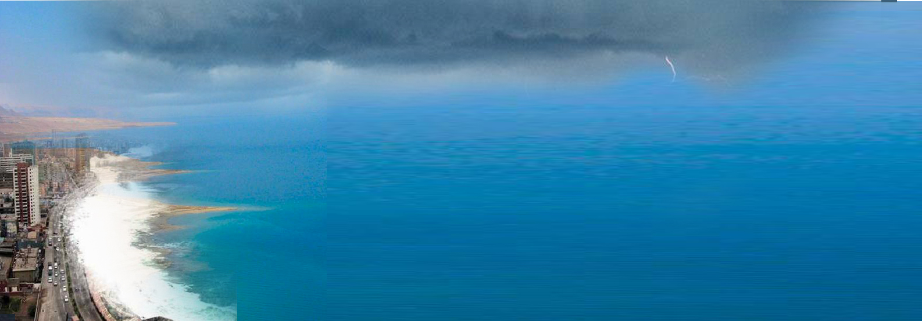
With Enzyme The Sea
will be calm
SKY
LAND
Pressure Above
NH₃ + So₂ + Co + PbO₂ + ZnO₂ + N₂O
With Enzyme
(CH₃COOH+O₁+O₂ = O₃+H₂O)
O₃ + NH₃ + SO₃ + Co +PbO₂ +ZnO₂ + N₂0
(N₂ S) - CH – Pb+ + Zn+ + NO₃
SEA
Feeding the Fish and Sea Weed
(N₂ S) – CH + O₂ Feeding
Amino Acid Formula

Slide 24
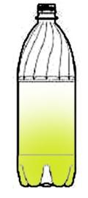
Pollution in the air
All oxide + (SO₂ ₊ ZnO₂ + PbO₂ ₊ Mercury Oxide) + O₃ + O₂ +N₂ = NO₃
Air 19% O₂ + 79%N₂ +(2% Argon)
Transform
Enzyme (CH₃COOH + Amino Acid + Hormone + Mineral Salt + Vitamin )
Enzyme
Natural salt
(NO₃ Natural Organic Fertilizer )
Protect soil disease
keep the Flies under the earth
200 bottle of Enzyme will release 1 meter high of O₃ and O₂ per day in the air

Slide 25
Duty of Enzyme :
Catalysis
Resolve; decompose
Transform; Change
Compose; combination
Enzyme act as KEY

Slide 26
环保酵素分解所得的臭氧(O₃)有杀菌的功能，而且还帮助增加空气中的含氧量，这就减少了空气中的废气(二氧化碳)热气和毒气等。
Ozone has been recognized as effective bleaching agent and a powerful disinfectant, killing bacteria and funguses more rapidly than chlorine. Ozone helps clean the air and give higher oxygen level in the environment.

Slide 27
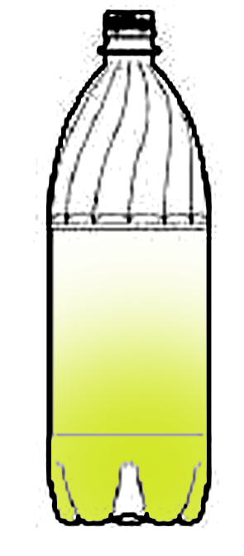
Enzyme Fermentation Process
酵素发酵步骤
CH₃COOH + CO₂ + O₂ + H₂O
O₃O₃
ORGANIC
Aerobic
需氧菌
Fermenting 发酵
H₂O
Sugar
Co₂
Anaerobic厌氧菌
(NH2-S-CH) +Vitamin + Mineral + Hormone

Slide 28
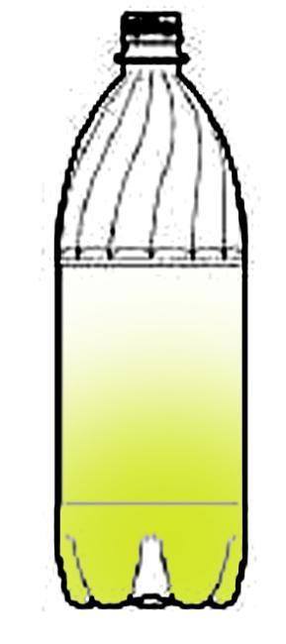
How Enzyme = O₃
Fruit Enzyme release O + CO₂ and N₂O
O + CO₂
+
O₂ (in the air)
O₃ + CO₂
Fruit Enzyme
酵素
N₂O
+ O₃
NO₃ to Feeding the plant
天然植物养分

Slide 29
From where O is create?
Alcohol
Aldehyde
H
O
Aerobic and Anaerobic fermentation
II
_
R – C – OH R – C – H
{O}
_
O
{O}
H
II
R – C
Free Oxygen Radical
OH
Carboxilic

Slide 30
Glucose Ethanol Acetic Acid
Enzyme (CH3COOH + Amino Acid + Hormone + Mineral Salt + Vitamin )
Alcohol
Methanol

Slide 31
酵素能
自然有效分解和消灭有害的微生物和人工化学污染物。
Enzyme has anti bacterial and anti-viral effects. It can also remove chemical pollutants easily and is a popular household cleanser.

Slide 32
Save the earth with the waste product from our kitchen
Mankind can live in toxic free environment and enjoy non toxic food.

Slide 33
GAEBAGE
ENZYME
Agriculture
Environment
Personal Health
FOR BETTER HEALTH
AND
CLEAN ENVIRONMENT

Slide 34
Agriculture

Slide 35
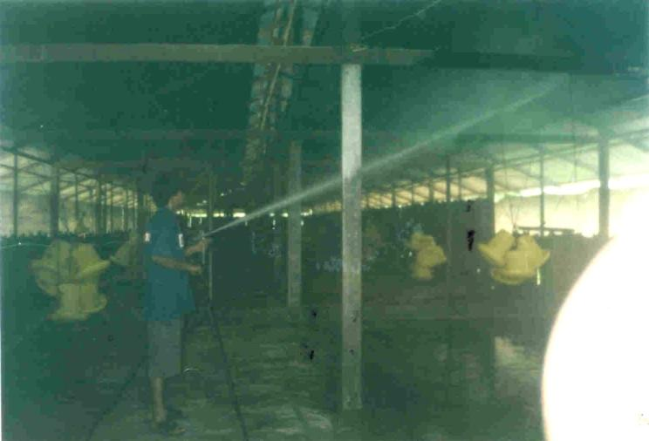
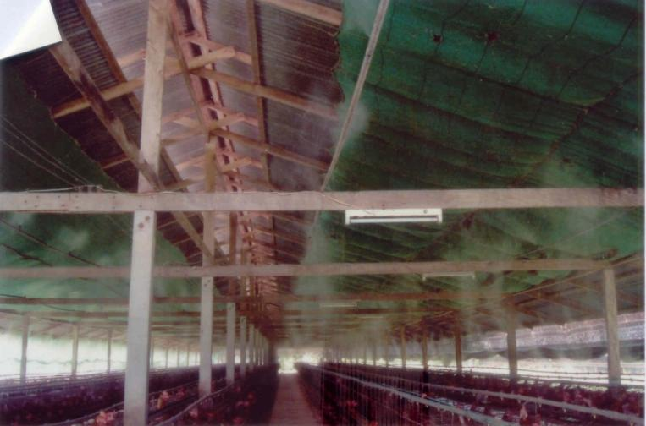
Spray Enzyme surrounding animal farm to reduce infection / insects away
It is proven that the farm is less smell and flies

Slide 36
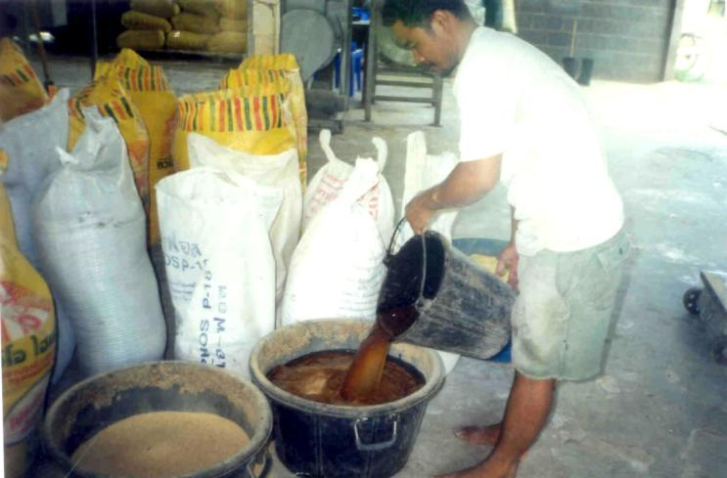
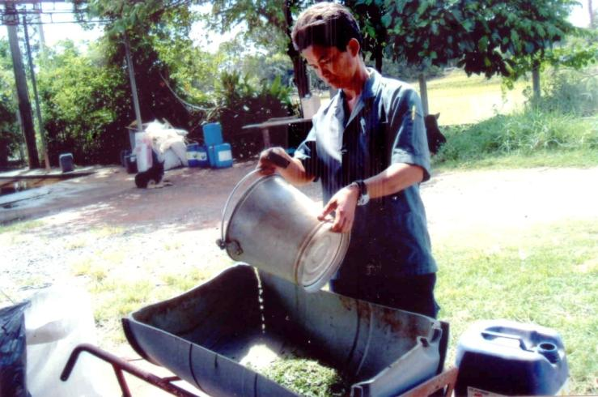
Adding Enzyme in the Feed
Enzyme mixed with dry stuff Enzyme mixed with grass

Slide 37
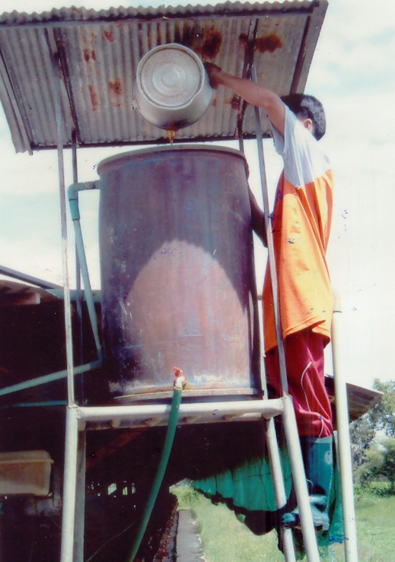
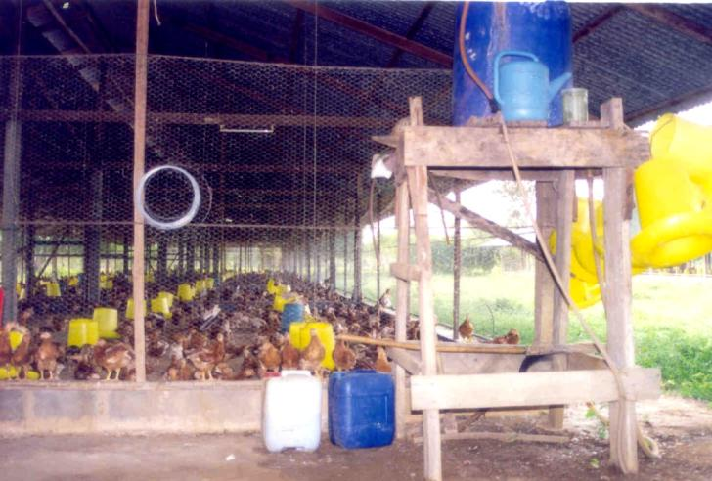
Enzyme is added into the water
to feed the animals

Slide 38
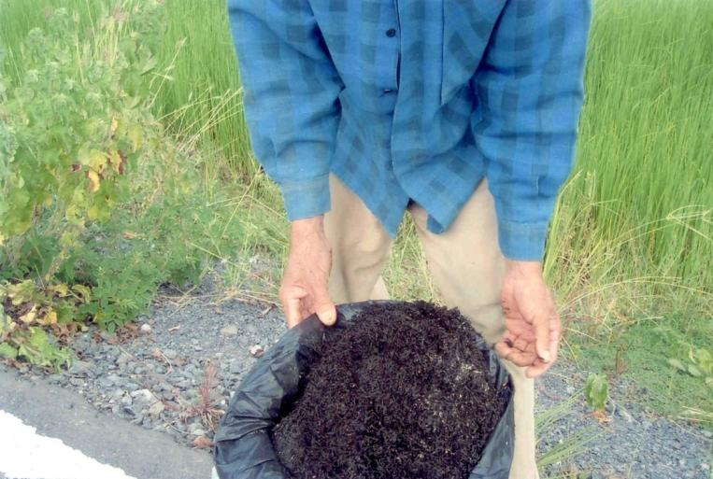
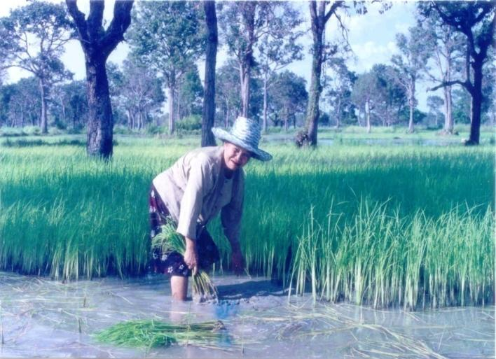
Natural feeding for plant from the Animals Manure

Slide 39
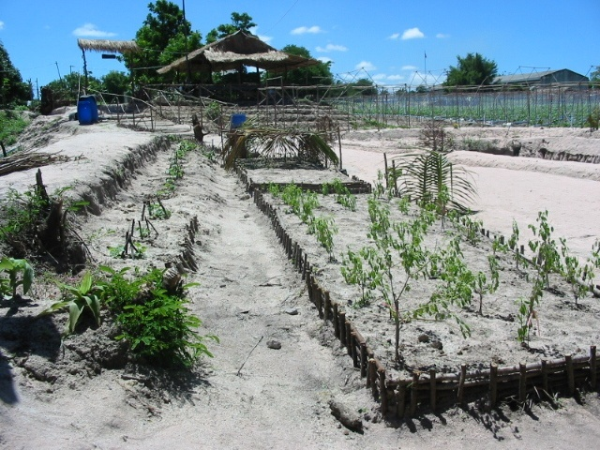
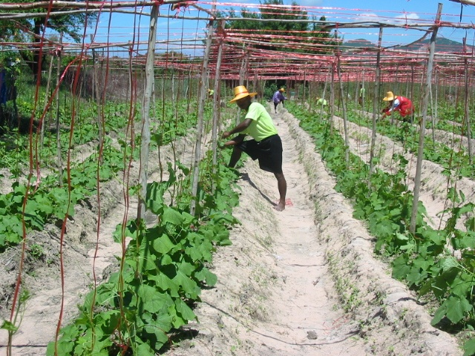
The transformation of unfertilized sandy land to prosperous healthy farm land
1st Month after use enzyme
2nd Month

Slide 40
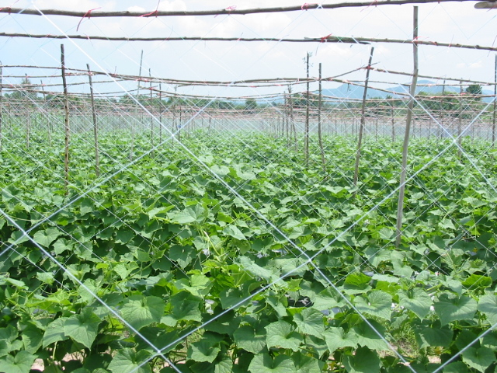
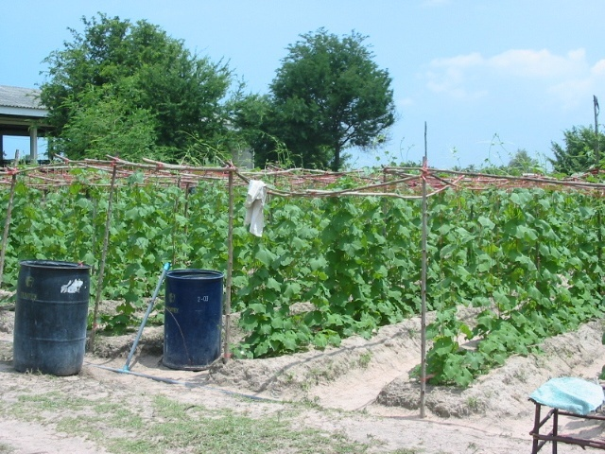
The progress of the plantation in the sandy soil land
3rd Month
4th Month
With Enzyme, the vegetable are grow and put into market earlier.

Slide 41
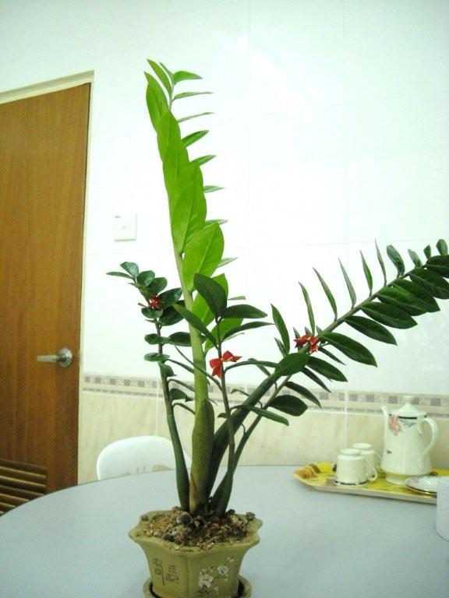
These two branches are newly grown after watering with enzyme. It is healthier, greener & bigger.
使用酵素后新长出茎干和叶子比原本树身大和壮。

Slide 42
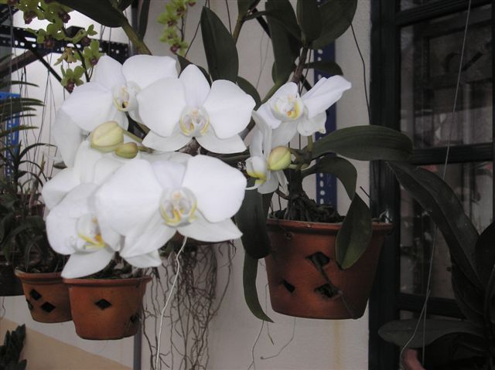
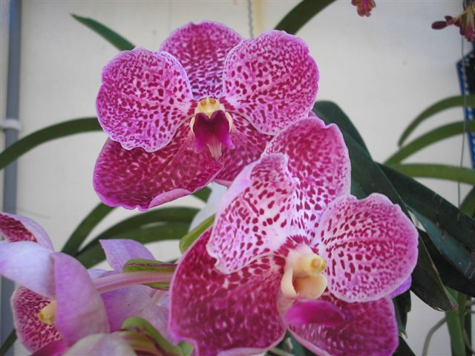
These Orchid are sprayed with enzyme once a week. The enzyme help to boost the process of blossom

Slide 43

The root are also stronger after sprayed with enzyme.

Slide 44

With Enzyme 60% Orchid is flowering every time.

Slide 45


Slide 46

Nearly 900g per fruit

Slide 47

No artificial fertilizer and chemical is using in this farm.
The tree growth very well.

Slide 48

With Enzyme the fruits is increase.

Slide 49

With Enzyme the vegetable growth well.

Slide 50

The period of vegetable growth is shorten, but the vegetable is sweets and big.

Slide 51

Harden soil, nothing can growth.

Slide 52

Treat with Enzyme the soil is soft and rich.

Slide 53

The pound after treat with enzyme the water is stay.

Slide 54

Before treat by enzyme water always dry up.

Slide 55
The to use of Garbage ENZYME
环保酵素的用法 :
Enzyme adds with water to dilute, it become more power.酵素加水稀釋後會更強
For fertilizer & pesticide 1cc : 1000cc
肥料 & 农药
2. For insecticide 1cc : 1000cc
昆蟲除蟲劑
For anti odour / air re-freshener dilute 1000x 空氣清新劑
As plant hormone to get more flower and fruit
種植、栽培花草、水果 dilute 500x

Slide 56
Save Environment by
ENZYME
酵素
保护家居环境

Slide 57

Classic Detergent vs. With Enzyme Detergent
普通清洁剂 对 加了酵素清洁剂
REVERSIBLE ACTION
IRREVERSIBLE ACTION

Slide 58


Slide 59


Slide 60


Slide 61




Slide 62



Slide 63

13/9/2008 before pouring enzyme

Slide 64

1st day Pouring Enzyme

Slide 65

14/9/2008 2nd day

Slide 66

15/9/2008 3rd day

Slide 67

16/9/2008 4th day

Slide 68

Feel the cool 感受酵素的清凉

Slide 69



Slide 70


Slide 71


Slide 72
House Hold 家居用品
Non-toxic & pollution free Kitchen
没有毒素污染的厨房
Remove the foul odor,
Mold and grime
去除怪气味, 霉菌, 尘垢, 污秽, 油污等

Slide 73




Remove moldy & oily Kitchen wall stain

Slide 74


Slide 75


Slide 76




THE USES OF GARBAGE ENZYME IN OUR HOMES
laundry floor mopping
mold removal grime removal

Slide 77



By using enzyme, it will
Reduce flies,
mosquitoes,
rats, cockroach
Take care / control
pets
Toilet without odor

Slide 78

Soak vegetable/fruit into water together with 2 spoon of enzyme for 30min, it will remove pesticide, herbicide, heave metal, worm from the vegetable. It will enhance the taste of the food.

Slide 79




MAKE-YOUR-OWN FRUIT & VEGGIE WASH
1. add a cap of enzyme 2. wash veggie throughly
3. put veggie in the basin 4. soak for 40 minutes

Slide 80

Follow the same steps for the fruits.
Washing your fruits and veggie with garbage enzyme, clean and free them from chemicals such as pesticide residue.

Slide 81
Personal Health

Slide 82


Slide 83


Slide 84


Slide 85


Slide 86


Slide 87


Slide 88


Slide 89


糖尿病
Diabetic

Slide 90


Slide 91


Slide 92

MAKE- YOUR- OWN BODYWASH
As a general rule
to prepare whatever household cleaning products of your own:
Use a marker
to make
10 equal lines on the container
as a measurement.

Slide 93



Add in:
1
2
3
1 part of bodywash 1 part of enzyme 8 parts of water

Slide 94

Apply the same formula to other cleaning products as well.

Slide 95
By the end those Enzyme will reach to the river & the sea and it will safe our environment.
酵素不仅可以代替一般家中的化学清洁用品，最后也会流到下水道，还可以一起净化河流与海洋,保护我们的环境。

Slide 96


Slide 97


Slide 98


Slide 99

To save the global and protect our next generation. We need everyone effort to make enzyme and use it..

Slide 100

These are the enzyme packed in the bottle to be given away to public for every Enzyme Public talk

Slide 101



Slide 102



Slide 103

Volunteers not only contributing their time and also financially support the enzyme project.
Their intention is to let everyone obtained a bottle after attended the public talk.

Slide 104
紅沙糖
Black Sugar
剩饭果皮
Kitchen Waste
水
Water
酿制3个月 Fermentation for 3 months
制做环保酵素的比率
Ratio Of Making Garbage Enzyme
: l
: 3
: 1 0

Slide 105

DO-IT-YOURSELF GARBAGE ENZYME
Things you’ll need:
air-tight
plastic container
water
kitchen scale
fruits or
vegetables
dregs
brown
sugar

Slide 106


1
2
Pour 10 ratio of water into the container.
Weigh the brown sugar.

Slide 107

Brown Sugar / Jaggery

Slide 108


3
4
Pour the brown sugar in.
Stir and mix them well.

Slide 109


Slide 110


5
6
Weigh the kitchen waste.
Add them in.

Slide 111


7
8
Stir and mix them well.
Close the cap and jot down the date the mission begins.

Slide 112


Slide 113

Fermentation process will take 3 months.

Slide 114




Day 1 1 month
2 months 3 months
Photos source: http://www.ueog.org

Slide 115

Enzyme water after ferment for 3 months

Slide 116

Garbage Enzyme (with worm)
Is fine with worms - extra proteins
Can add extra 1 ratio sugar and cover air tight.
The worms will dissolve

Slide 117




end of fermentation filter to remove residue
enzyme ready for use residue as fertilizer

Slide 118
请注意Reminder
1. After mixing the brown sugar/jaggery into the water, add in the kitchen waste. Let it ferment for 3 months.
酵素必需发酵至少三个月。
2. During fermentation, need to open the cover to release the gas. Remember to close back.
發酵过程偶尔必需扭松瓶盖，讓氣體流出平时就把盖封闭。
3. After 3 months, extract out the water and leave only the sediment. The sediment can be dried to become fertilizer or may leave it for next fermentation.
三个月后，酿制好的酵素可泼开中间抽取酵素水，垃圾渣可以拿来晒乾，搅碎后埋在土里作肥料，或者继续留放在缸底和下次的鲜垃圾再次酿制垃圾酵素。

Slide 119
请注意Reminder
4. Enzyme never expires . The longer you keep stronger it become.
酵素不會過期發酵越久越好 。
5. Enzyme added with water will enhance the power.
酵素加水稀釋後會更強。
6. Garbage enzyme is only for external use.
只供外用！
Any more QUESTIONS?

Slide 120
如果所有的人都把自己家里的垃圾转化为有用的垃圾酵素，不仅保护地球，而且会使人类生活在没有毒害的空气里，
食物也将远离毒素。
If every household utilizes their garbage to produce Enzyme, the Ozone layer can be protected. Mankind can live in toxic free environment and enjoy non-toxic food.

Slide 121

谢谢您！
爱我们的地球！
Your presence here today
is the first step to help reduce
Global Warming and save our Mother Earth.
Thank you
for taking
this step.
Image source: http://www.americanmeditation.org

Slide 122

谢谢您
！
爱我们的地球
ＴＨＡＮＫ
ＹＯＵ！
Dr. (H) Joean Oon
email :enzyme4u@gmail.com
Blog: enzymesos.blogspot.com

